Slide 1

McGraw-Hill Technology Education
Copyright © 2006 by The McGraw-Hill Companies, Inc. All rights reserved.

Slide 2
Chapter 4B
Printing

Slide 3
Commonly Used Printers
Impact printers
  Generate output by striking the paper
  Uses an inked ribbon
Non-impact printers
  Use methods other than force
  Tend to be quiet and fast

Slide 4
Commonly Used Printers
Dot matrix printers
  Impact printer
  Used to print to multi-sheet pages
  Print head strikes inked ribbon
  Line printers
  Band printers
  Speed measured in characters per second
Notes:
Teaching Tip
Figure 4B.5 on page 163 provides an excellent rendering of how the print head works. Be sure to refer to the image as you teach.

Slide 5
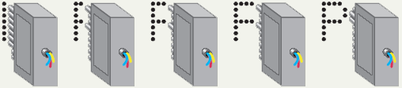
Dot Matrix Print Head

Slide 6
Commonly Used Printers
Ink-jet printers
  Non-impact printer
  Inexpensive home printer
  Color output common using CMYK
    Cyan, magenta, yellow, black
  Sprays ink onto paper
  Speed measured in pages per minute
  Quality expressed as dots per inch
Notes:
Insider information
Nearly all of the electronics for the printer is kept in the ink cartridge. Thus, when the cartridge is replaced the printing components of the printer are replaced. Refilling cartridges is OK, but should not be reused more than 2-3 times.

Slide 7
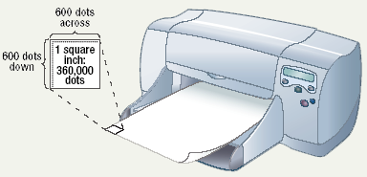
Dots Per Inch

Slide 8
Commonly Used Printers
Laser printer
  Non-impact printer
  Produces high quality documents
  Color or black and white
  Print process
    Laser draws text on page
    Toner sticks to text
    Toner melted to page
  Speed measured in pages per minute
  Quality expressed as dots per inch
Notes:
Insider information
The laser printer works on a similar process to a photocopier. The first photocopier as we know it today was invented in Astoria NY in 1938 by Chester Carlson and Otto Kornei.

Slide 9
Commonly Used Printers
All-in-one peripherals
  Scanner, copier, printer and fax
  Popular in home offices
  Prices are very reasonable

Slide 10
Comparing Printers
Determine what you need
Determine what you can spend
Initial cost
Cost of operating
Image quality
Speed

Slide 11
High-Quality Printers
Special purpose printers
  Used by a print shop
  Output is professional grade
  Prints to a variety of surfaces

Slide 12
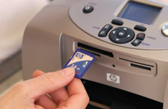
High-Quality Printers
Photo printers
  Produces film quality pictures
  Prints very slow
  Prints a variety of sizes

Slide 13
High-Quality Printers
Thermal wax printers
  Produces bold color output
  Color generated by melting wax
  Colors do not bleed
  Operation costs are low
  Output is slow

Slide 14
High-Quality Printers
Dye sublimation printers
  Produces realistic output
  Very high quality
  Color is produced by evaporating ink
  Operation costs are high
  Output is very slow

Slide 15
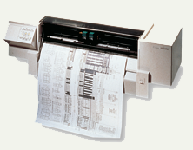
High-Quality Printers
Plotters
  Large high quality blueprints
  Older models draw with pens
  Operational costs are low
  Output is very slow

Slide 16
Chapter 4B
End of Chapter

